Slide 1
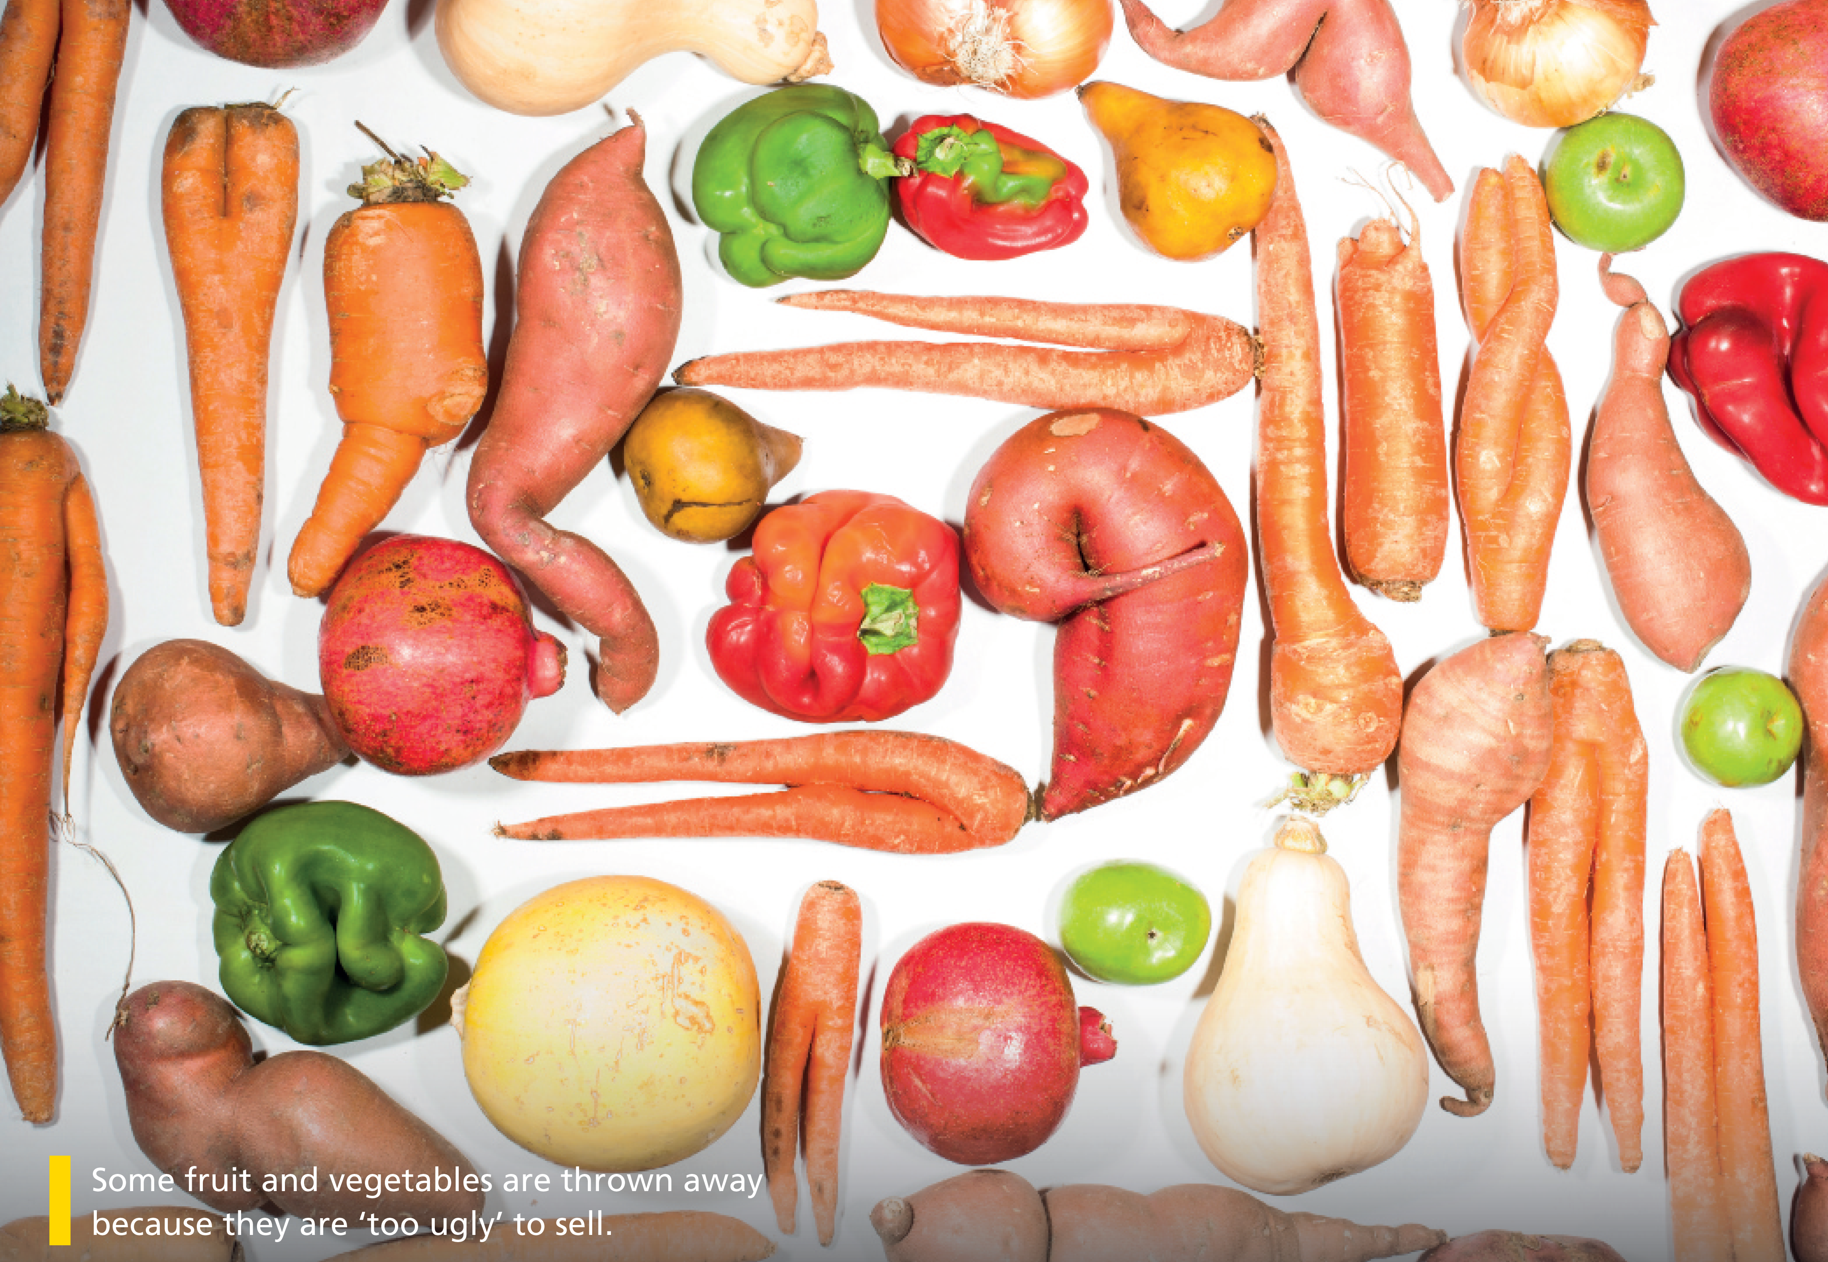

Bringing the world to the classroom and the classroom to life
NGL.CENGAGE.COM/ELT
A PART OF CENGAGE

Slide 2

FEATURES
58 Pizza with a pedigree
Traditional dishes get special status
60 Imaginary eating
Discover the power of your mind!
62 A caffeine-fuelled world
An in-depth look at the role of caffeine in modern life
66 Dangerous dining
A video about an unusual Japanese delicacy
Unit 5-p. 57

Slide 3
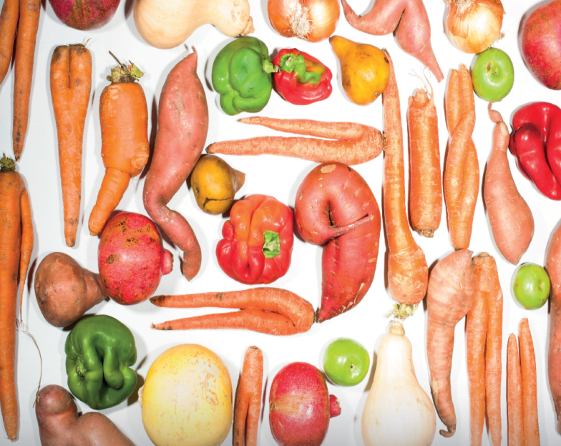
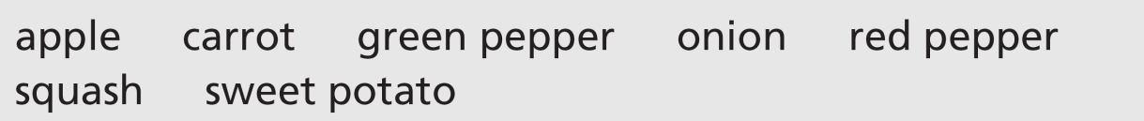
1 Find these foods in the photo. Which ones do you eat? How often do you eat them?
Some fruit and vegetables are thrown away because they are ‘too ugly’ to sell.
apple: there are three small green apples visible on the right hand side of the photo
carrot: there are many orange carrots arranged vertically and horizontally in the photo
green pepper: there are two green peppers visible
onion: there is an onion in the top right corner near the apple
red pepper: there are three red peppers visible
squash: there is one pale coloured squash
sweet potato: there are several strangely-shaped sweet potatoes
In addition there are two pears and two pomegranates.
Unit 5-p. 57

Slide 4

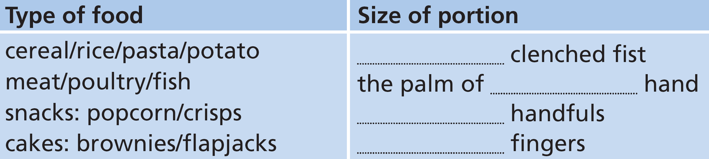
2 Work in pairs. Discuss the questions.
1 How much do you know about the recommended amount of different food groups you should eat each day?
2 How do you decide what is the right size of a portion of food?
3 Does everyone need to eat the same amounts?
Students’ own ideas
3 Work in pairs. What do you think the portion sizes of these types of food are? Listen to an extract from a radio programme about food. Complete the table.
Track 34
one/your
your
two (of your own)
two (of your own)
Unit 5-p. 57

Slide 5
Script
Track 34
Really, the first thing to say about food is that everyone has different needs. That means we can’t say ‘a portion should be this size’. What you have to do is eat for the size that you are. So, children obviously need to eat less than adults, and most women need to eat less than most men. How do you know how much to eat? Use your body as a guide. So for a typical adult woman, the amount of cereal or rice in a portion is the same size as your clenched fist. Notice I say your, not a fist. It’s the size of your hand that matters. If you’re eating a piece of meat, then make sure it’s no bigger than the palm of your hand. For snacks like popcorn, the biggest portion size is two of your own handfuls. And
for cakes, which we all know we need to be careful with, then the portion should be the size of two of your fingers. That doesn’t sound like very much? Exactly!

Slide 6
4 Discuss the questions with your partner.
1 Does any of the information in Exercise 3 surprise you?
2 How much attention do you pay to your diet?
3 In what ways can food and diet influence your health?
Students’ own ideas
Unit 5-p. 57

Slide 7

5a Pizza with a pedigree
Reading
1 Work in pairs. Discuss the questions.
1 What are the traditional dishes of your country or region?
2 How often do you eat or make these dishes?
3 How often do you eat or make dishes from other countries? Which ones?
4 What’s your favourite pizza? What’s on it?
Students’ own answers
5a-p. 58

Slide 8
2 Read the news item Pizza with a pedigree. Answer the questions.
1 Why is Pizza Napoletana in the news?
2 What are some of the other foods in the same group as Pizza Napoletana?
3 What are the rules for an ‘authentic’ Pizza Napoletana?
1 It’s in the news because it has become a European Union-certified food and drink product.
2 Scottish Farmed Salmon, Spanish Melon from la Mancha and English Blue Stilton cheese.
3 The diameter, thickness of crust, ingredients and application of ingredients are regulated.
5a-p. 58

Slide 9

Track 35
Pizza with a pedigree
There is pizza – and there is Pizza Napoletana. The two, experts say, have as much in common as virgin olive oil has with ordinary cooking oil. Now, authentic Pizza Napoletana is one of the elite group of European Union-certified food and drink products – like Scottish Farmed Salmon, Spanish Melon from La Mancha and English Blue Stilton cheese. In order to qualify for this list, these food products had to pass strict tests.
Once a product achieves Guaranteed Traditional Speciality status, other similar products are not allowed to use the same name. For example, if your sparkling wine doesn’t come from the Champagne region of France, you can’t call it ‘Champagne’. But be warned: the EU specifications for ‘real’ Pizza Napoletana are very complicated – it takes almost as long to read them as it does to make the pizza. To be labelled ‘Guaranteed Traditional Speciality’, the pizza mustn’t be over 35 centimetres in diameter and the crust mustn’t be more than two centimetres thick. The ingredients must include type 00 flour and up to 100 grams of San Marzano tomatoes applied in a spiral. And the cheese has to be fresh ‘Mozzarella di Bufala’.
5a-p. 58

Slide 10
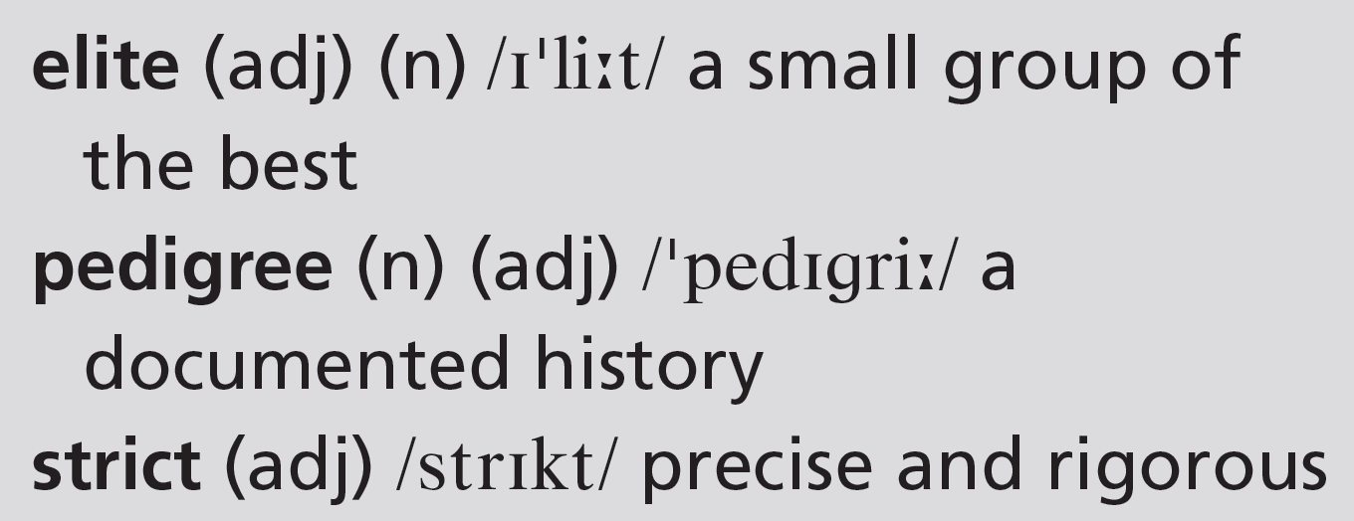
Track 35
Of course, pizza has a long history in Italy. The word ‘pizza’ first appeared in an AD 997 manuscript from Gaeta, a southern Italian town. A millennium later, in 1997, political groups in northern Italy tried to ban pizza because it was a symbol of their rivals in the south. You don’t have to know anything about pizza’s history to enjoy eating it, of course. But you should try an authentic Pizza Napoletana at least once, and see if you can taste the difference!
5a-p. 58

Slide 11
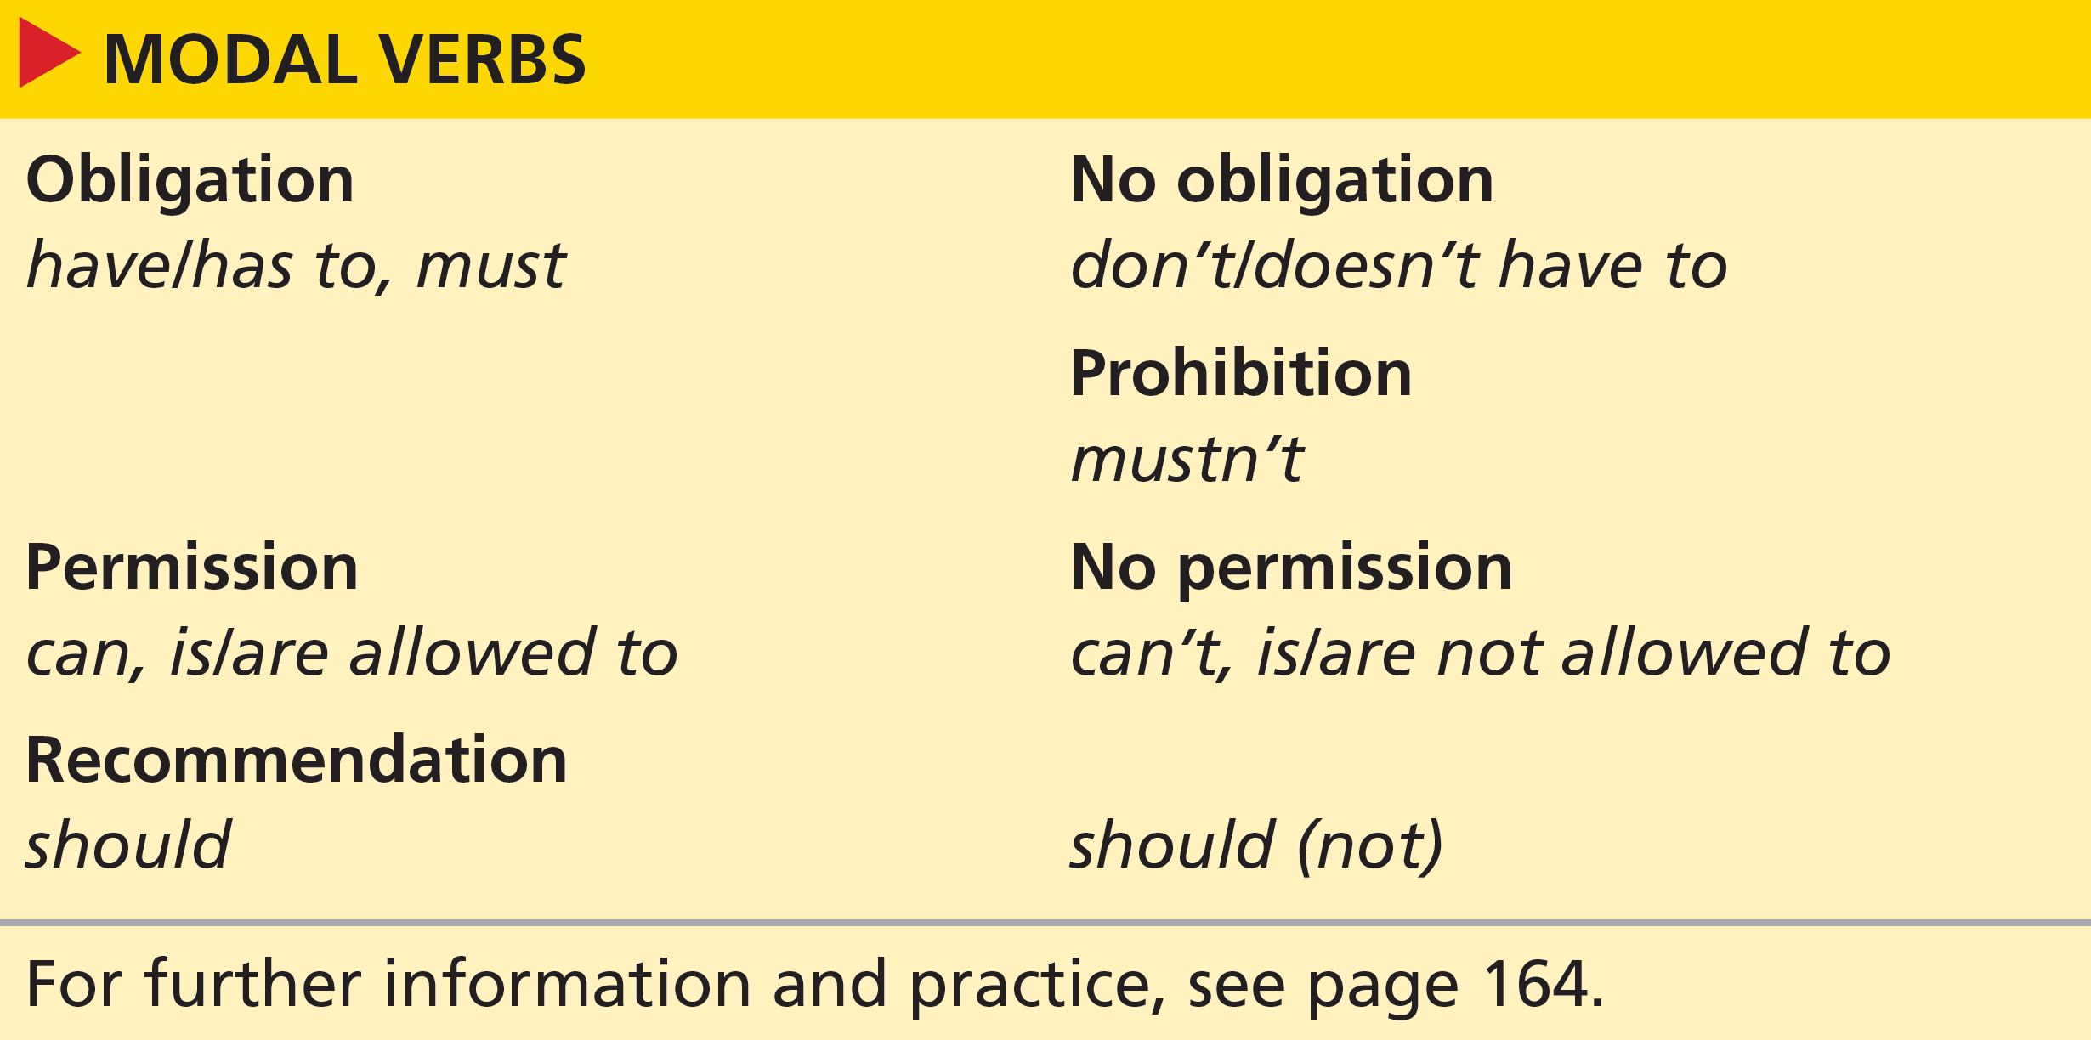

Grammar modal verbs (1)
1 verbs forms in the news item: can’t, mustn’t, must, has to, should, don’t have to
3 Look at the grammar box. Answer these questions.
1 Which verb forms from the box are in the news item? Underline the verb forms in both the box and in the news item.
2 What form do we use to talk about obligation in the past? Circle this form in the news item.
3 Two of the modal verbs in the news item do not express rules. Which verbs?
2 had to: … these food products had to meet very strict criteria.
3 do not express rules: should, don’t have to (see Grammar notes)
5a-p. 58

Slide 12
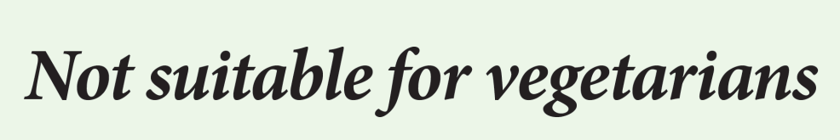

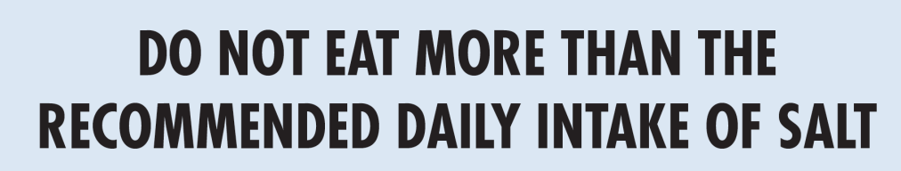
4 Read the labels from food packaging. Look at the example. Write sentences using one of the modal verbs in brackets.
1 Vegetarians shouldn‘t eat/drink/use this product.
1
(shouldn’t / don’t have to)
Vegetarians shouldn’t eat this product.
2 People with nut allergies mustn’t eat this product.
2
(don’t have to / mustn’t)
3 You shouldn’t eat more than the recommended daily intake of salt.
3
(can / shouldn’t)
5a-p. 59

Slide 13
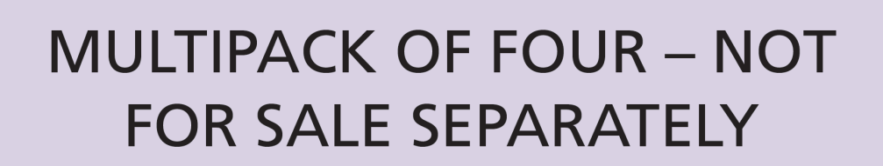
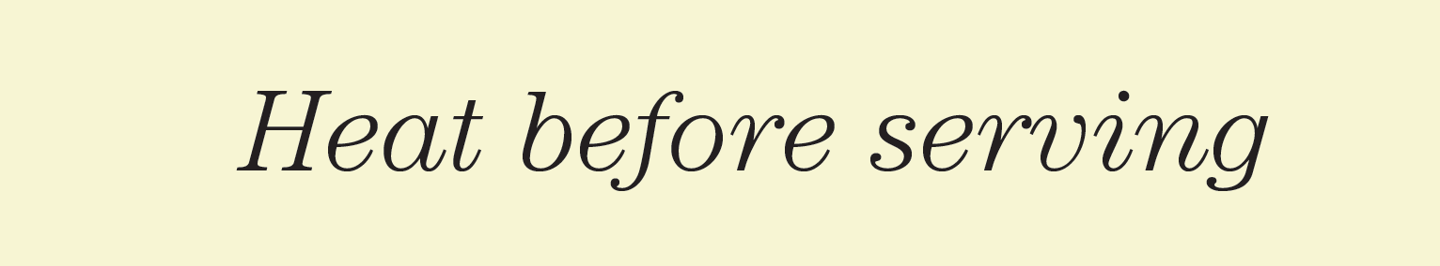

4 You are not allowed to sell the four items (in the multipack) separately.
4
(don’t have to / not allowed to)
5 You have to heat this product before serving.
5
(can / have to)
6 Diabetics shouldn’t eat/drink/use this product.
6
(allowed to / shouldn’t)
5a-p. 59

Slide 14
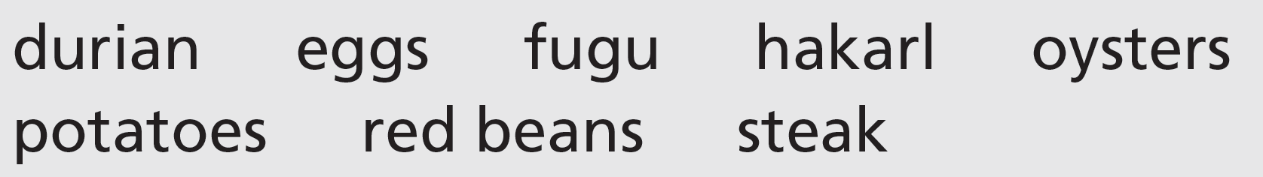
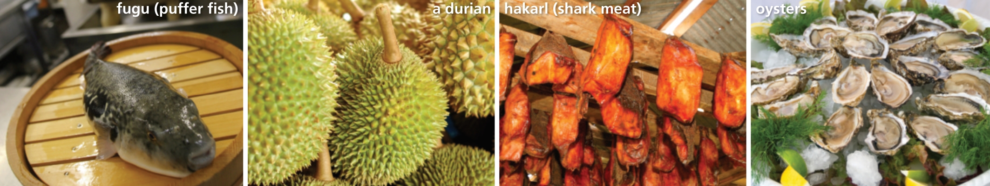
5 Work in pairs. Look at these food items. Discuss the questions.
1 Have you eaten any of these food items?
2 Do you know of any special treatment these things need before you can eat them?
5a-p. 59

Slide 15
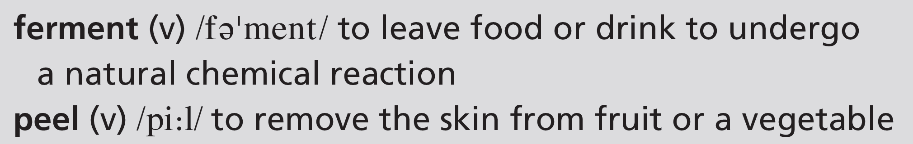
6 Listen to eight short conversations about the food items in Exercise 5. Complete the notes for each item.
Track 36
1 durian: you aren’t allowed to __________________________________
2 fugu: ____________________ are allowed to ____________________
3 hakarl: you have to __________________________________
4 potatoes: you don’t have to __________________________________
5 oysters: you mustn’t __________________________________
6 eggs: you should _________________________________________
7 red beans: ______________ must ______________________________
8 steak: you can __________________________________
take durian on buses in Singapore
only qualified chefs
prepare fugu
ferment hakarl first
peel potatoes before you boil them
eat oysters in summer / in the warm summer months
avoid using raw eggs in mayonnaise
you
boil red beans for fifteen minutes
eat steak raw
5a-p. 59

Slide 16
Script
Track 36
1
A: I’ve never tried durian. Have you? Apparently, it tastes much better than it smells.
B: No, I haven’t tried it. But I know that it smells so much that you aren’t allowed to take it on buses in Singapore.
2
C: What’s fugu? F– U– G–U?
D: Oh, I know what it is. It’s a kind of fish they eat in Japan. It’s actually poisonous, so only qualified chefs are allowed to prepare it in restaurants. If you eat the wrong part, it can kill you!
3
E: Can you eat shark meat?
F: Yes, it’s popular in lots of countries. Sometimes, you have to ferment it first because the fresh meat is bad for you. That’s what they do in Iceland. It’s called hakarl there.
4
G: Are you going to boil those potatoes like that, without peeling them?
H: Yeah, why? You don’t have to peel potatoes before you boil them.
G: Yes, you do. At least that’s what we do in my house!

Slide 17
Script
Track 36
5
I: I love eating oysters, but I can never remember when it’s safe to eat them.
J: The rule is you mustn’t eat them in the warm summer months, but I don’t know why not.
6
K: I feel a bit sick. I wonder if it was the mayonnaise on my salad?
L: Was it fresh mayonnaise? You should avoid using raw eggs in mayonnaise, didn’t you know? They can make you ill.
7
M: Are you making chilli con carne?
N: Yes, but the recipe says you must boil red beans for fifteen minutes or they aren’t safe to eat. Do you think that’s right?
8
O: What’s this on the menu? Steak tartare? Is that raw steak?
P: Yes, you can eat steak raw. It’s cut into very thin pieces. You should try it.

Slide 18
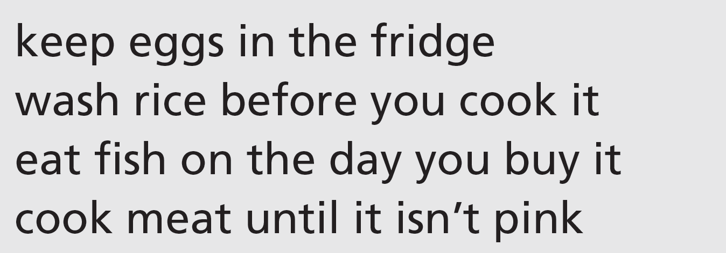
7 Pronunciation weak forms
a Listen to the sentences from conversations 1–4 in Exercise 6. Notice how to is not stressed. Repeat the sentences.
Track 37
b Work in pairs. Decide if you (don’t) have to do these things. Discuss with your partner.
5a-p.59

Slide 19
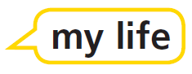
Speaking
8 Work in pairs. Write down at least two ideas for each topic.
1 rules you had to follow when you were in primary school
2 information that should be on food labels
3 places where you’re not allowed to eat hot food
4 table manners
5 things you’re only allowed to do when you’re eighteen
6 questions you shouldn’t ask someone you don’t know well
5a-p. 59

Slide 20
9 Work with a new partner. Compare your ideas from Exercise 8. Do you both agree?
A: When we were at primary school, we had to line up outside the classroom.
B: Oh, yes! So did we!
Students’ own answers. However, here are some ideas you could suggest if students need them:
1 school times, school uniform, be quiet in class
2 number of calories, type of ingredients, ingredients like nuts that could be dangerous
3 on a bus, in a cinema, in the street (in some countries)
4 eat with your mouth closed, ask for things – don’t reach for them, pass things to other people, don’t start eating until everybody is ready, keep your arms close to your body, use the right fork and knife
5 get married, drive, join the army, vote, drink alcohol, go in a nightclub, watch a horror film (each of these depend on the country though, and some will be allowed with parental consent at 16)
6 This depends on culture but typical answers are: age, salary, marital status, religious or political beliefs
5a-p. 59

Slide 21
5b Imaginary eating
Reading and listening
1 Work in pairs. Discuss the statements. Do you agree with them? Give examples to support your arguments.
1 Self-belief: the difference between a winner and a runner-up is in attitude, not skill.
2 Willpower: you can achieve anything if you think you can do it.
3 Train your mind: people who consider themselves to be lucky have more ‘lucky’ moments.
EXAMPLE ANSWERS
1 Self-belief: e.g. Many top athletes don’t win until they really believe they can.
2 Willpower: e.g. It takes willpower to give up addictive foods.
3 Train your mind: e.g. If you think you will do well when you take an exam, you are more likely to be calm and positive and do well than if you have a negative mindset.
5b-p. 60

Slide 22
2 Read the news item Imaginary eating. What does the imaginary eating technique involve?
It consists of imagining you are eating a specific food because research shows that you want to eat the food less if you imagine eating it.
5b-p. 60

Slide 23
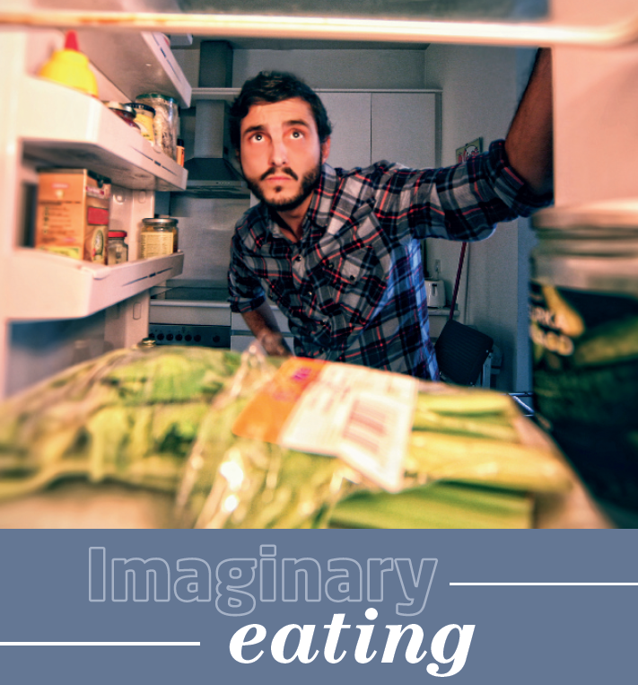
Obesity rates are climbing fast and we need to find new techniques to help people control overeating. According to new research, ‘imaginary eating’ could be one such technique. It’s based on the idea that if you are less interested in a certain food, you will eat less of it. But how do you reduce your interest? A psychologist in the United States reports that if you just imagine eating a specific food, your interest in it will drop. Often people try not to think about food when they need to lose weight. But avoiding these thoughts might not be a good strategy. With imaginary eating, if you force yourself to think about chewing and swallowing food,
you’ll actually reduce your desire to eat.
Track 38
Christine Dell’Amore
National Geographic News
5b-p. 60

Slide 24


Comments
Track 38
Rpineapple23
This study is just another proof of how powerful our brain is. The better we are at using that power when making decisions and controlling certain behaviours, the healthier we will become.
Christine Dell’Amore
National Geographic News
5b-p. 60

Slide 25
3 Listen to two people discussing the news item. Are these sentences true (T) or false (F)?
Track 39
1 Jack doesn’t believe the claims in the news item.
2 Lin is open-minded about the idea of imaginary eating.
3 Both of them agree that willpower is important.
4 Lin thinks Jack should try out the technique.
5 Lin eats too many crisps and snacks.
6 Jack is going to buy some chocolate.
1 T (What a load of rubbish! I’ve never heard anything so ridiculous.)
2 T (It said if you think about eating food, you stop wanting to eat it so much. So if you don’t eat it, then you might lose weight. I thought it made sense.)
3 T (L: I think willpower is really important, especially where food is concerned … J: … mental attitude is important when you’re trying to change something in your life.)
4 F (J: So are you going to do this imaginary eating thing, then? Do you really think it’ll work? L: Yeah, why not? I won’t find out unless I try.)
5 T (L: I eat too many crisps and snacks, right?)
6 T (J: I’m going to buy you some chocolate just in case.)
5b-p. 60

Slide 26
4 Listen to the conversation again. Match the beginnings of the sentences (1–6) with the endings (a–f).
Track 39
e
f
d
c
a
b
1 I’ll believe it
2 If you don’t train your mind,
3 I won’t find out
4 When I want to eat a snack,
5 I’ll never need to buy chocolate again
6 As soon as it starts working,
a if this technique works.
b I’ll let you know.
c I’ll try just imagining it.
d unless I try.
e when I see it.
f you won’t be able to lose weight.
5b-p. 60

Slide 27
Script
Track 39
L = Lin, J = Jack
L: Hi, Jack. Have you read this item on imaginary eating?
J: Hi, Lin. Yes, I saw it this morning. What a load of rubbish! I’ve never heard anything so ridiculous. If we think about eating food, we’ll lose weight, it said.
L: Not exactly. It said if you think about eating food, you stop wanting to eat it so much. So if you don’t eat it, then you might lose weight. I thought it made sense.
J: No, it’s rubbish. I’ll believe it when I see it! You can’t ‘think yourself thin’.
L: Well, I’m not so sure. I think willpower is really important, especially where food is concerned. Imagine you are overweight and you want to lose a few kilos. If you don’t train your mind, you won’t be able to lose weight. I reckon you can achieve anything if you believe you can do it.
J: You mean like ‘mind over body’? Well, OK, mental attitude is important when you’re trying to change something in your life. But I don’t think that’s the same as what the news item said. So are you going to do this imaginary eating thing, then? Do you really think it’ll work?
L: Yeah, why not? I won’t find out unless I try.
J: And what exactly are you going to do, then?
L: OK, let’s think. I eat too many crisps and snacks, right? So, when I want to eat a snack, I’ll try just imagining that I’m eating it. Hey, you know what? This could be amazing. I’ll never need to buy chocolate again if this technique works!
J: Well, I can’t believe my ears!
L: Hey, as soon as it starts working, I’ll let you know. Self-belief, that’s what’s important.
J: I’m going to buy you some chocolate just in case. I think you’ll need it.

Slide 28
5 Read the comment at the end of the news item again. Do you agree with the comment? With your partner, write a comment to add to the comments section.
EXAMPLE ANSWERS
I don’t agree with this idea – I think it is more important to eat a balanced diet.
I think this makes sense – by concentrating on what we do, we are able to control what we do.
I find this hard to believe – when I imagine eating something I always want to eat it more!
I think this could work – perhaps by imagining we are doing it we can trick our body and make us think we’ve already eaten it.
5b-p. 60

Slide 29
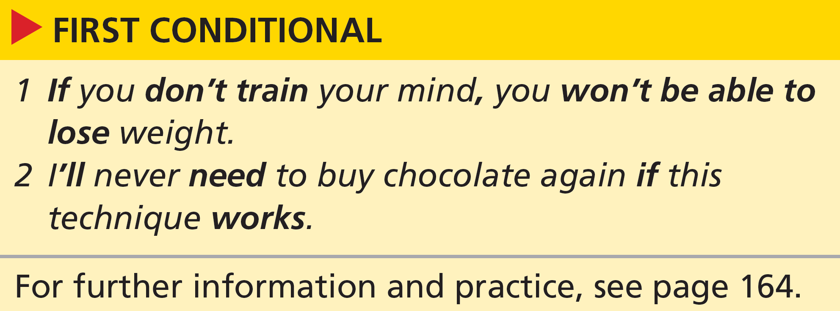
Grammar first conditional
6 Look at the grammar box. Answer the questions.
a Which verb forms are used to make the first conditional?
b Where can if go in conditional sentences?
c Look at the position of if in the sentences. When do we use a comma (,)?
d Which of the sentences refers to future possibility and which refers to something which is generally true?
e Find three sentences with the first conditional pattern in the news item. Do the sentences refer to future possibility or to something which is generally true?
See next slide for answers
2b-p. 61

Slide 30
Exercise 6
a If + present simple, will + infinitive without to
b at the start or in the middle, joining the two clauses
c We use a comma when if is used at the start.
d Sentence 2 refers to future possibility and sentence 1 refers to something which is generally true.
e 1 if you are less interested in a certain food, you will eat less of it
(something which is generally true)
2 if you just imagine eating a specific food, your interest in it will drop
(something which is generally true)
3 if you force yourself to think about chewing and swallowing food, you’ll
actually reduce your desire to eat (future possibility)
2b-p. 61

Slide 31
7 Complete the sentences with the present simple and will + infinitive. Which sentences refer to future possibility and which refer to something which is generally true?
1 If you _________________ (believe) in yourself, you __________________________________________ (be) more successful.
2 I _________________ (need) a lot of willpower if I ________________________ (want) to give up chocolate.
3 If you _______________ (not buy) snacks, you ________________________________ (not be able) to eat them.
4 If you _______________ (find) any more information, ___________________________________ (you / let) me know?
5 If you _______________ (reduce) the amount of food on your plate, you _______________________________________ (lose) weight.
believe
’ll be (something which is generally true)
’ll need
want (future possibility)
don’t buy
won’t be able (future possibility)
find
will you let (future possibility)
reduce
’ll lose (something which is generally true)
Note this could also be used for future possibility. It’s the context that makes it clear.
5b-p. 61

Slide 32
6 I _______________ (give up) junk food if you ______________________ (do) too.
7 If I _______________ (not try) it, _______________________________ (never know).
8 ______________ we ______________ (eat) less if we _____________________________________ (use) smaller plates?
’ll give up
do (future possibility)
don’t try
’ll never know (future possibility)
Will
eat
use (something which is generally true)
Note this could also be used for future possibility. It’s the context that makes it clear.
5b-p. 61

Slide 33
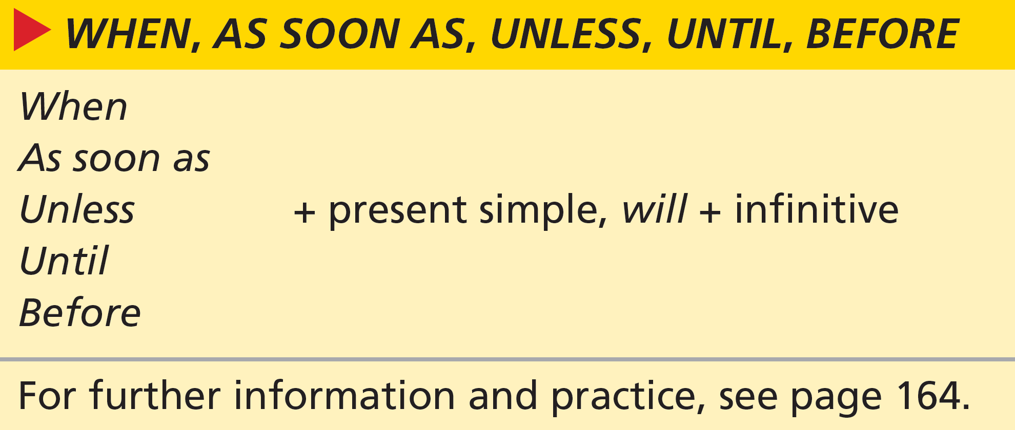
8 Jack and Lin are discussing Lin’s efforts to eat more healthily. Cross out any options which are not possible.
1 You won’t change as soon as / unless you make an effort.
2 As soon as / When you make up your mind, you’ll be able to act.
3 I’ll weigh myself before / when I start my diet.
4 I’ll keep trying before / until I see a change.
5 You won’t see any results unless / when you try hard.
6 If / Unless you give up easily, you won’t achieve your target.
7 If / When you go shopping, don’t buy sweets.
8 I’ll follow the diet unless / until I lose ten kilos.
both are correct
both are correct
both are correct
5b-p. 61

Slide 34
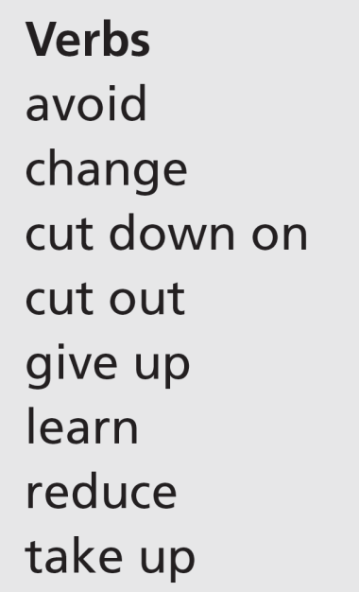
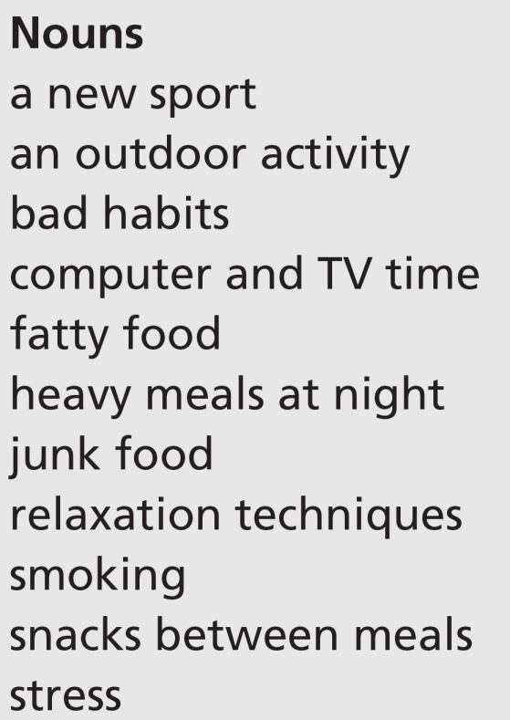
Vocabulary a healthy lifestyle
9 Work in pairs. Match the verbs with the nouns to make strategies for a healthy lifestyle. You can match some verbs with more than one noun and some nouns with more than one verb. Add ideas of your own.
avoid: fatty food, heavy meals at night, junk food, snacks between meals change: bad habits
cut down on: computer and TV time, fatty food, heavy meals at night, junk food, snacks between meals
cut out: fatty food, heavy meals at night, junk food, snacks between meals
give up: bad habits, junk food, smoking
learn: a new sport, relaxation techniques
reduce: computer and TV time, stress
take up: a new sport, an outdoor activity
5b-p. 61

Slide 35
10 Think of a specific result for each strategy from Exercise 9. Write sentences with the first conditional.
If you avoid heavy meals at night, you’ll sleep better.
EXAMPLE ANSWERS
If you avoid heavy meals at night, you’ll sleep better.
If you cut down on fatty food, you’ll lose weight.
If you give up smoking, you’ll live longer.
If you reduce stress, you’ll feel happier.
If you take up a new sport, you’ll get fit.
If you cut out snacks between meals, you’ll improve your appetite.
5b-p. 61

Slide 36
Speaking
EXAMPLE ANSWERS
11 Work in pairs. Make a list of all the possible consequences you would face in these situations.
1 giving up junk food:
(+) feel healthier, eat more nuts and fruit, lose weight, have more energy, save money
(–) miss going to burger bars, etc.; shopping and cooking takes longer
2 changing your job/studies:
(+) get a better job or study something more interesting; feels exciting and new
(–) stressful, may not like it as much, have to make new friends, new things to learn
3 sharing a flat with friends:
(+) fun, shared experiences, independence from parents
(–) more expensive than being at home, arguments, untidy place, miss home
4 taking up extreme sports:
(+) fun, exciting, new adventures, new friends
(–) dangerous, scary, may have an accident, expensive
1 giving up junk food
2 changing your job/studies
3 sharing a flat with friends
4 taking up extreme sports
5b-p. 61

Slide 37
12 Work in groups of four. The aim of this game is to keep answering questions as long as you can. Student A is going to do one of the things in Exercise 11. The rest of the group asks the questions. If Student A can’t answer, Student B takes a turn, and so on.
A: I’m going to give up junk food.
B: What will you eat when you want a snack?
A: Don’t worry. If I want a snack, I’ll eat nuts or some fruit.
C: And what if you find out you’re allergic to nuts?
5b-p. 61

Slide 38
5c A caffeine-fuelled world
Reading
1 Work in groups. Discuss the questions.
1 Is your lifestyle very different to that of your parents’ generation? In what way(s)?
2 Do you often hear comments about modern life? What kind of comments?
3 How much tea/coffee or other drinks do you have in a normal day?
Students’ own answers
2 Read the article on page 63 quickly. Choose the correct option to complete the sentence.
The article is about caffeine and children / daily life / sugar.
5c-p. 62

Slide 39

Track 40
Over the centuries, people have created many traditions around preparing and drinking their favourite drinks, tea and coffee. Just think of the Japanese tea ceremony, British afternoon tea or the morning coffee custom in many societies. Why are these drinks so popular? The answer is their secret ingredient – caffeine. In the modern world, the new caffeine ‘delivery systems’ are canned ‘energy’ drinks. And the more modern our world gets, the more we seem to need caffeine.
Caffeinated drinks make you less tired and more alert. This double power of caffeine to reduce physical tiredness and increase alertness is part of the reason why it is the world’s most popular mood-changing drug. It is the only habit-forming drug we routinely serve to our children (in all those soft drinks and chocolate bars). In fact, most babies in the developed world are born with tiny amounts of caffeine in their bodies.
5c-p. 63

Slide 40
Track 40
Most people don’t think twice about their caffeine intake being harmful. However, it raises blood pressure and so increases the risk of heart disease. That’s why the use of caffeine is considered to be a problem by scientists and public health authorities. In the United States, for example, many canned energy drinks carry warnings. In most European countries, manufacturers have to label cans with warnings. But in France and Denmark you are not even allowed to sell energy drinks.
On the other hand, there’s also research which suggests that caffeine may have benefits for human health. It helps relieve pain, reduces asthma symptoms and increases reaction speed.
And it seems we need coffee – or Diet Coke® or Red Bull – to get us out of bed and back to work. Charles Czeisler, a neuroscientist at Harvard Medical School, explains that traditionally people went to sleep and woke up following sunset and sunrise. Then the way we worked changed and people did more indoor jobs. Consequently, we had to adapt. Electric light and caffeinated food and drink allowed people to follow a less natural work pattern. Therefore, without caffeine, the 24-hour society of the developed world simply couldn’t exist.
5c-p. 63

Slide 41
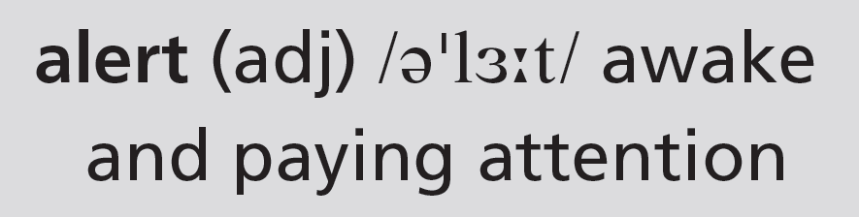
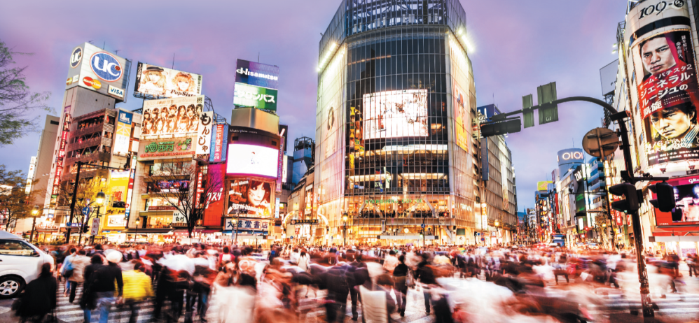
Track 40
Czeisler says, ‘Caffeine helps people try to ignore the natural human rhythms.’ He warns us that ‘there is a heavy, heavy price to pay’ for all this extra alertness. Without enough sleep – the traditional eight hours out of each 24 is about right – the human body will not function at its best, either physically, mentally, or emotionally, the doctor says.
According to Czeisler, the modern desire for caffeine is a ‘Catch 22 situation’. ‘The main reason that people want caffeine is to stay awake,’ he says. ‘But the main reason that people can’t stay awake is they don’t get enough regular sleep – because they use caffeine.’
The Shibuya Crossing in Tokyo, Japan is always busy.
5c-p. 63

Slide 42
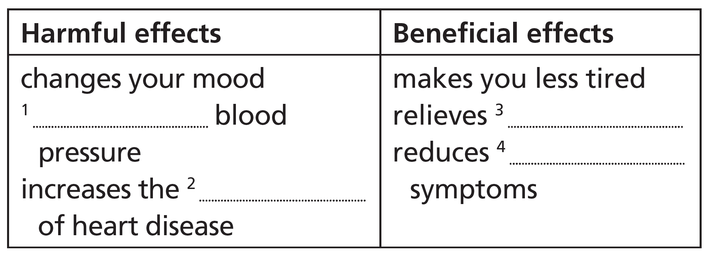
3 What are the effects of caffeine? Complete the table.
increases
pain
asthma
risk
4 Complete these sentences with words from the article.
1 Caffeine is an _____________ of tea, coffee, soft drinks, energy drinks and chocolate.
2 Caffeine is a drug which changes your _____________.
3 Several countries put health _____________ on energy drinks.
4 People have changed to a less natural work _____________.
5 Caffeine is popular with people who need to stay _____________.
ingredient
mood
warnings
pattern
awake
5 Work in pairs. Do you think anything the writer says is true about your own lifestyle? What?
5c-p. 62

Slide 43
Critical thinking writer’s purpose
6 What is the writer’s main purpose in this article? Give reasons for your answer.
to entertain / to inform / to persuade the reader
Students should include some of the information in the answer key to Exercise 7 when they give reasons.
7 Look at the list of features which are typical of informative texts. Find examples in the article.
1 the present simple
2 the third person
3 questions and answers
4 facts
5 specific examples
6 quotes, often from experts
7 linkers to show how ideas are connected
See next slide for answers
5c-p. 62

Slide 44
Exercise 7
1 present simple: used throughout, especially in paragraphs 1 (think, are, is, gets, seem), 2, 3, 5 and 6
2 third person: the first person (I) is never used
3 questions and answers: Why are these drinks so popular? The answer is their secret ingredient – caffeine.
4 facts: Caffeinated drinks make you less tired and more alert; In fact, most babies in the developed world are born with tiny amounts of caffeine in their bodies; … it [caffeine] raises blood pressure and so increases the risk of heart disease.
5 specific examples: In the United States, for example, many canned energy drinks carry warnings. / In most European countries, manufacturers have to label cans with warnings. But in France and Denmark you are not even allowed to sell energy drinks.
6 quotes, often from experts: Czeisler says, ‘Caffeine helps people try to ignore the natural human rhythms.’ He warns us that ‘there is a heavy, heavy price to pay’ for all this extra alertness; According to Czeisler, the modern desire for caffeine is a ‘Catch 22 situation’. ‘The main reason that people want caffeine is to stay awake,’ he says. ‘But the main reason that people can’t stay awake is they don’t get enough regular sleep – because they use caffeine.’
7 linkers to show how ideas are connected: In fact; However; But; On the other hand; And; Consequently; Therefore

Slide 45
8 Work in pairs. Discuss the questions.
1 Do you think the writer is successful in his/ her purpose?
2 Did you change your ideas about caffeine after reading the article?
3 In what way has the article influenced your opinion of caffeine?
1 The author is successful in informing the reader. Here are some of the many examples: Caffeinated drinks make you less tired and more alert … it raises blood pressure and so increases the risk of heart disease … there’s also research which suggests that caffeine may have benefits for human health.
2 Students' own answers
3 Students' own answers
5c-p. 62

Slide 46
Word focus so
9 Look at how so is used in the article. In which sentence can we replace so with as a result? What can replace so in the other sentence?
1 Why are these drinks so popular?
2 It raises blood pressure and so increases the risk of heart disease.
We can replace so with as a result in sentence 2.
We can replace so in sentence 1 with very or really.
5c-p. 62

Slide 47
10 Work in pairs. Complete the sentences. Then write two-line exchanges using some of the sentences. Act out your exchanges.
1 I’ve had five cups of ____________________ so far today.
2 Thank you so much for ____________________ you’ve done.
3 I’m so happy I could _______________________.
4 __________________________ me so I know when to expect you.
5 I think I’m right. I ____________________ so.
6 No, I don’t ____________________ so.
7 Don’t be so hard on yourself – it’s not easy to give up _______________________________.
8 Oh, that’s ________________________________________! So did I!
tea/coffee
what/all/everything
sing/dance/die/kiss you
Call/Ring/Text/Message
hope
think
chocolate/smoking/everything
remarkable/amazing/a coincidence
Students’ own ideas for the two-line dialogues
5c-p. 62

Slide 48
Speaking
11 Complete the slogans about modern life with these words. Where do you think the slogans are from?
1 We never _____________.
2 See the films of tomorrow _____________.
3 Open _____________ hours.
4 ‘Always’ _____________ broadband.
5 Late _____________ shopping every Thursday.
6 All _____________ breakfasts served here.
close
today
all
on
night
day
Students' own ideas for where the slogans are from, but see the Background information box for suggestions.
5c-p. 62

Slide 49
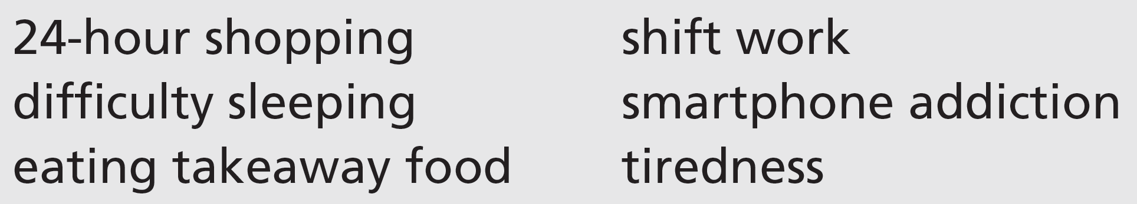
12 Work in small groups. These things are typical of a 24-hour society. Discuss the questions.
1 Are the things positive or negative?
2 Which ones affect you? In what way?
3 What are some of the consequences for you or for other people?
Students' own ideas
5c-p. 62

